Slide 1

A decade of democratic and structural turbulence: Myanmar’s subjective well-being trajectory
2014-2024
Phyllis Lun, Levi Stutzman, Felix Cheung
PWB Lab Summer Research Clinic
July 3rd, 2025

Slide 2
Table of Content
Background
Rising number of war and conflict worldwide
Theoretical background
PWB Lab’s work on war and conflict
Study on Syria civil war, Russian invasion of Ukraine, aftermath of Afghanistan war
Research and higher-level insights from these studies
Primer on Myanmar
History and status quo
Mental health and well-being consequences following the 2021 coup d'état
Current Study

Slide 3
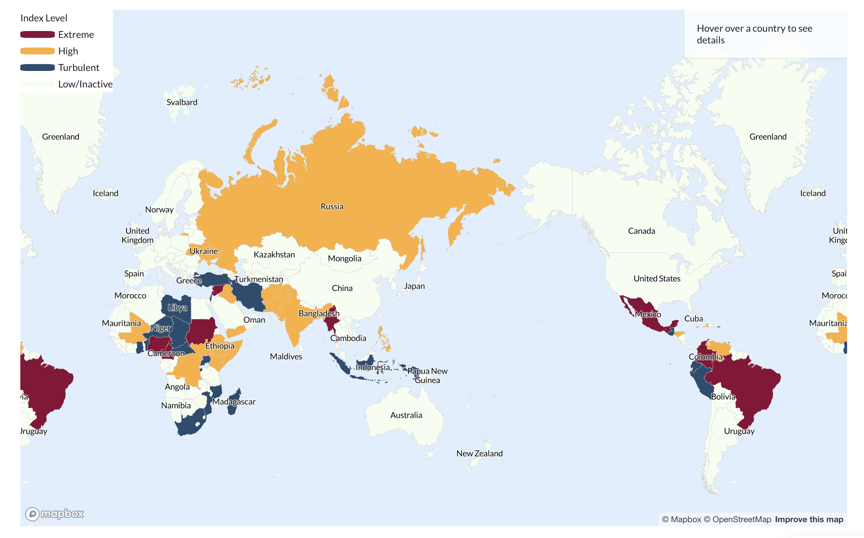
Rise of war and conflict worldwide
In the last five years, 100 countries engaged in some form of external conflicts (Institute for Economics & Peace, 2024)
In 2024, 1/8 people worldwide was exposed to war and conflict (Raleigh & Kishi, 2024)
Conflict disrupts peace and has significant economic, health, and psychological implications that reverberates across socioeconomic identities and transcend borders (Kóczán & Chupilkin, 2022; Raleigh et al., 2023; Charlson et al., 2019)
Institute for Economics & Peace. (2024). Global Peace Index 2024: Measuring Peace in a Complex World. http://visionofhumanity.org/resources
Kóczán, Z., & Chupilkin, M. (2022, December 14). The economic consequences of war. Centre for Economic Policy Research. https://cepr.org/voxeu/columns/economic-consequences-war
Raleigh, C., & Kishi, K. (2024). Conflict Index Results: January 2024. Armed Conflict Location & Event Data. https://acleddata.com/conflict-index/index-january-2024/
Raleigh, C., Kishi, R., & Linke, A. (2023). Political instability patterns are obscured by conflict dataset scope conditions, sources, and coding choices. Humanities and Social Sciences Communications, 10(1), 74. https://doi.org/10.1057/s41599-023-01559-4
Charlson, F., Ommeren, M. van, Flaxman, A., Cornett, J., Whiteford, H., & Saxena, S. (2019). New WHO prevalence estimates of mental disorders in conflict settings: A systematic review and meta-analysis. The Lancet, 394(10194), 240–248. https://doi.org/10.1016/S0140-6736(19)30934-1

Slide 4
Why do we study subjective well-being in war and conflict settings?
Conventional psychological research on well-being has a temporal and geographical bias.
The current knowledge base…
may not capture the full spectrum of human experience
may not generalize to increasingly prevalent conflict and wartime settings
e.g., Sustainable Happiness Model and its critiques (Lyubomirsky et al., 2005; Brown & Rohrer, 2020)
Brown, N. J. L., & Rohrer, J. M. (2020). Easy as (Happiness) Pie? A Critical Evaluation of a Popular Model of the Determinants of Well-Being. Journal of Happiness Studies, 21(4), 1285–1301. https://doi.org/10.1007/s10902-019-00128-4
Lyubomirsky, S., Sheldon, K. M., & Schkade, D. (2005). Pursuing Happiness: The Architecture of Sustainable Change. Review of General Psychology, 9(2), 111–131. https://doi.org/10.1037/1089-2680.9.2.111\
Notes:
Based on this popular theoretical model, it would lead to a counter-intuitive hypothesis that large-scale war and conflict may have a minimal impact on people’s well-being.

Slide 5
However, our work in the last few years has shown that war and conflict, the most drastic disruption of life circumstances, indeed have hampered humans’ ability to live their best lives.

Slide 6
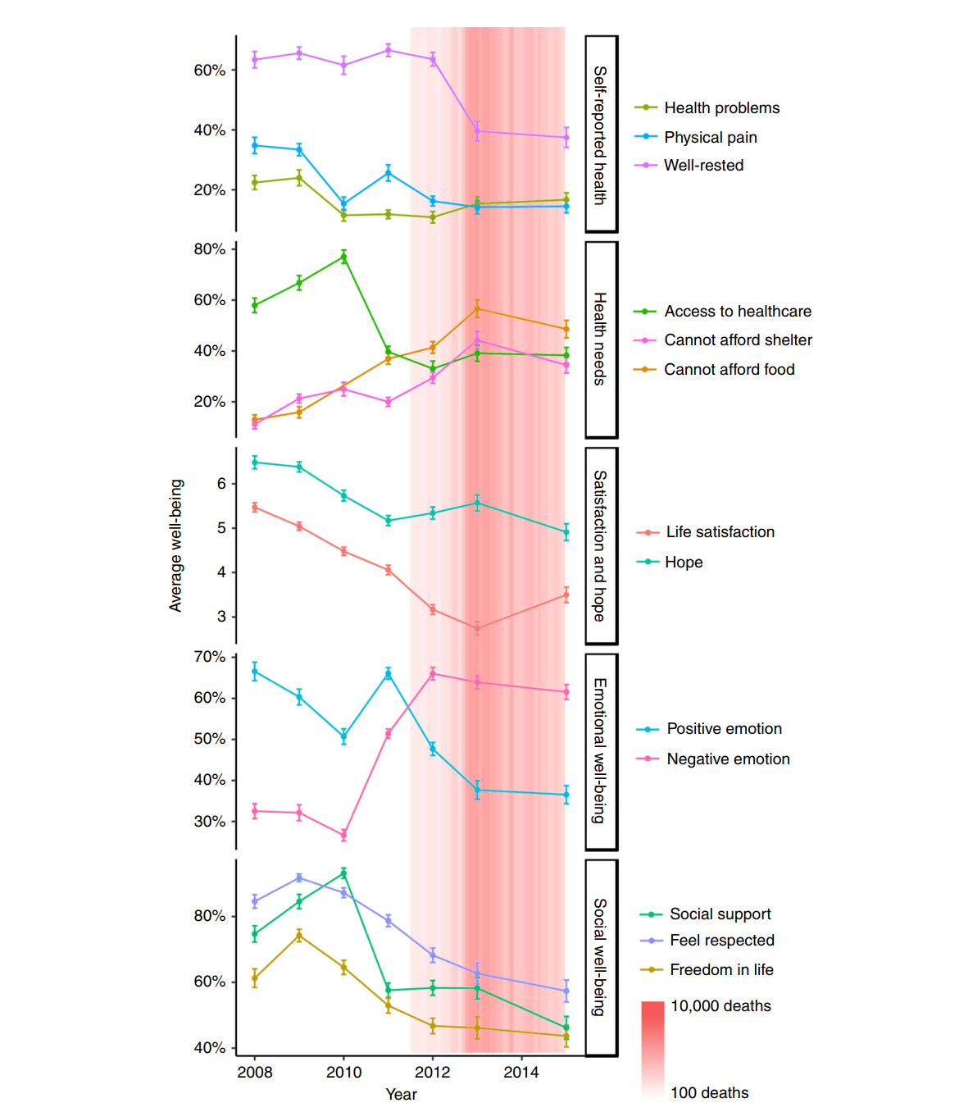
Syrian Civil War
One of the first PWB studies on war and conflicts
Started in 2011 as part of the Arab Spring protests, and quickly escalated to years long of armed conflicts between the then Assad government and opposition forces
Results
41% increase in negative affect
Drop in life satisfaction coincided with severity of conflict
5 times less social support than before the war
Minimal age and gender difference in well-being
Cheung, C., Kube, A., Tay, L., Diener, E., Jackson, J., Lucas, R., Ni, M., & Leung, G. (2020). The impact of the Syrian conflict on population well-being. Nature Communications, 11. https://doi.org/10.1038/s41467-020-17369-0

Slide 7
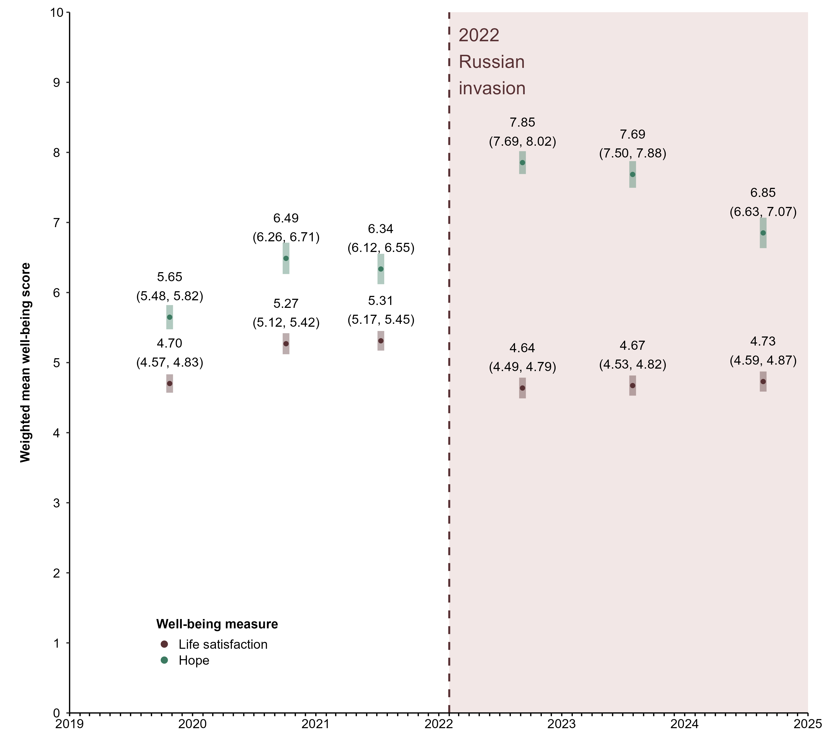
Russo-Ukrainian War
Russia’s full-scale invasion of Ukraine in Feb 2022
Deadliest conflict in Europe since World War II
Results
Ukraine
11th /120 steepest life satisfaction decline worldwide and largest increase in hope
decline in life satisfaction was a widespread phenomenon
Russia
increase in both life satisfaction and hope
Stutzman, L. D., Archer Lee, Y., Gardiner, G., Cheung, F. & Lun, P., (In prep). The Impact of the 2022 Russian invasion on Ukrainian well-being, Russian well-being, and global attitudes towards Russia
Notes:
Approximately 70,000 Ukrainian combatants and 13,000 Ukrainian civilians are reported to have died since the invasion

Slide 8
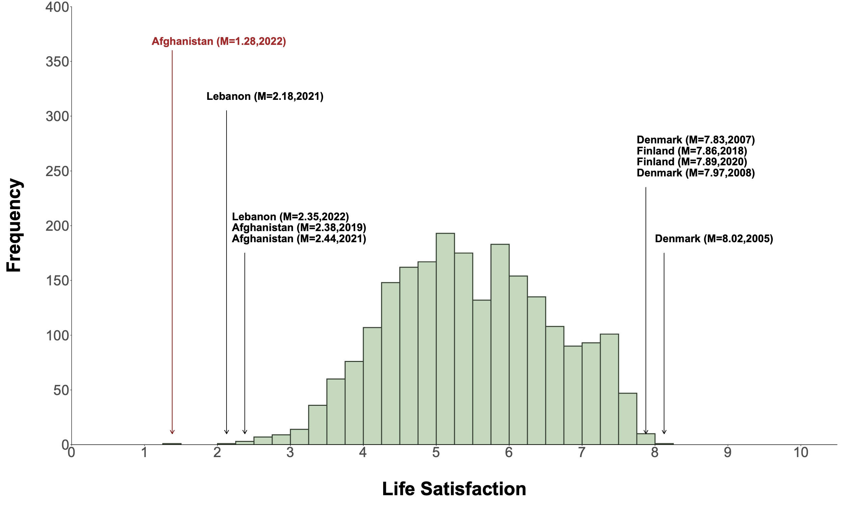
Aftermath of War in Afghanistan
Well-being trends from 2018-2019, 2021, and 2022
Results
Comparable average life satisfaction scores before and during the withdrawal but sharp decline under Taliban ruling
In 2022: almost all reported a life satisfaction score < 5, and 2/3 reported score of 0 or 1
Stutzman, L. D., Lun, P., Yang, M., Chan, K., & Cheung, F. (2025). Epilogue to the war: Afghanistan reports the lowest well-being in recorded history. Science Advances, 11(22), eads4156. https://doi.org/10.1126/sciadv.ads4156
Notes:
In addition to investigating population well-being trajectories in prolonged war and conflict, we wondered if the end of a war would necessarily translate to improved subjective well-being for an embattled population. For this, we turned to the War in Afghanistan which commenced following the 9/11 terrorist attack in New York, 2001 and the US’s military actions to combat terrorism.

Slide 9
Research Insights
Drastic changes in life circumstances could result in enduring changes in subjective well-being of the affected populations.
Context matters a lot.
More well-being research in diverse settings is needed.
Notes:
Drastic changes in life circumstances (from starting of a war to conclusion of a war without prudent planning) could result in enduring changes in subjective well-being of the affected populations, even in the presence of the usual protective factors (e.g., better social support, being female, and high income and education levels).
Context matters a lot. The impetus of every war is different. Developing an understanding of the historical, cultural, and political context of the countries/ settings where the conflicts take place is essential for well-being researchers to conduct the study. Example: Geographical differences in subjective well-being due to e.g., exposure to conflict and allegiance to certain political groups
Studying individual conflicts offer us the opportunity to tease apart the common well-being impacts of conflicts, while highlighting the some of the forgotten conflicts happening in the world.

Slide 10
Higher-level Insights
The line of research is motivated by…
Our shared goal to do the best science that we can
Injustice that we observe in research and in the world broadly where the suffering of civilians from war and conflict is rampant but forgotten
Institution that is UofT, particularly PWB Lab, allows us to conduct this line of research safely and freely

Slide 11
A decade of democratic and structural turbulence:
Myanmar’s subjective well-being trajectory in 2014-2024

Slide 12


Slide 13

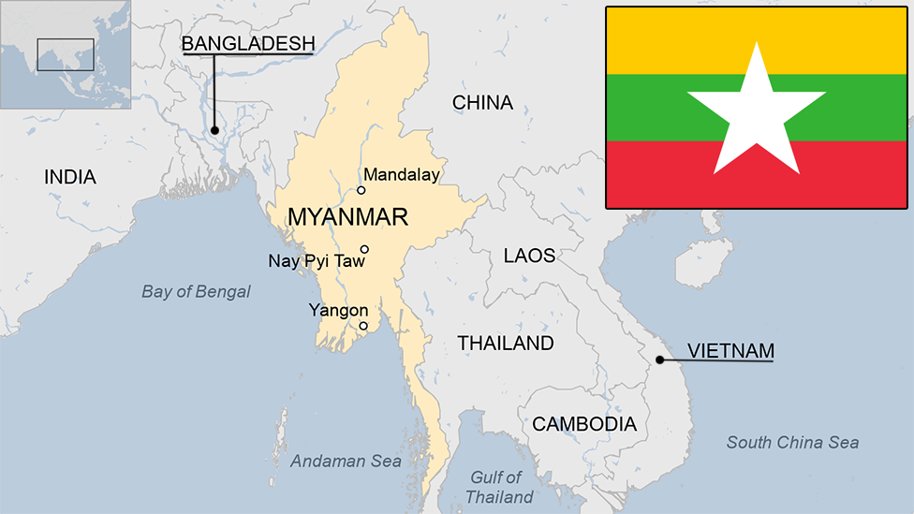
Primer on Myanmar and the Myanmar Civil War
Situated in southeast Asia
Independence from the British Empire in 1948
Currently with an estimated population of 54 million and over 130 ethnic groups
Oscillating between parliamentary democracy and autocratic ruling by the military junta, the Tatmadaw
British Burma Flag (1939-1948)
(BBC)

Slide 14
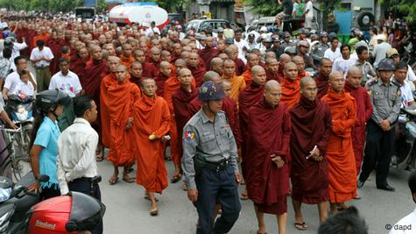
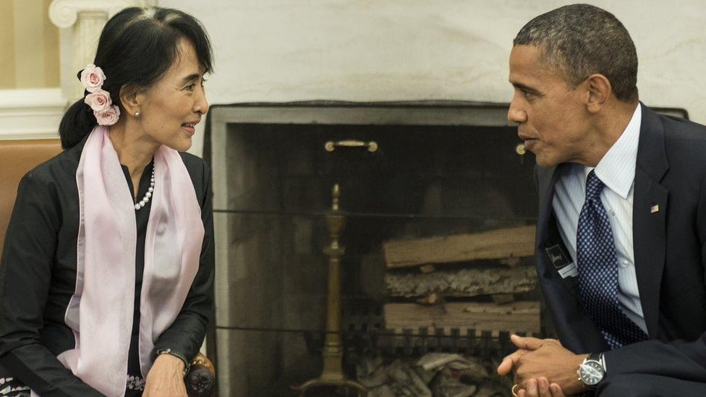
Primer on Myanmar and the Myanmar Civil War
2007: Saffron Revolution
2008: Constitution to give the Tatmadaw more control
2011: Political reforms began after enforcing the 2008 Constitution
2012: National League for Democracy (NLP), founded and led by Aung San Suu Kyi since 1988
Winning the parliamentary by-election that year and the national elections in 2015
Subsequently National Elections in November 2020
(AFP)
Notes:
The protests were triggered by the decision of the national military government to remove subsidies on the sales prices of fuel. The national government is the only supplier of fuels and the removal of the price subsidy immediately caused diesel and petrol prices to increase by 66–100% and the price of compressed natural gas for buses to increase 500% in less than a week.[
Last for 6 weeks
(e.g. loosening media censorship, freeing political prisoners, and strengthening international relations, sanctioning pro-democratic parties for elections)
Aung San Suu Kyi, 1991 Nobel Peace Prize winner
While her image had suffered internationally due to her response to the crisis that befell Myanmar's mostly Muslim Rohingya minority, she remains hugely popular with the country's Buddhist majority.

Slide 15
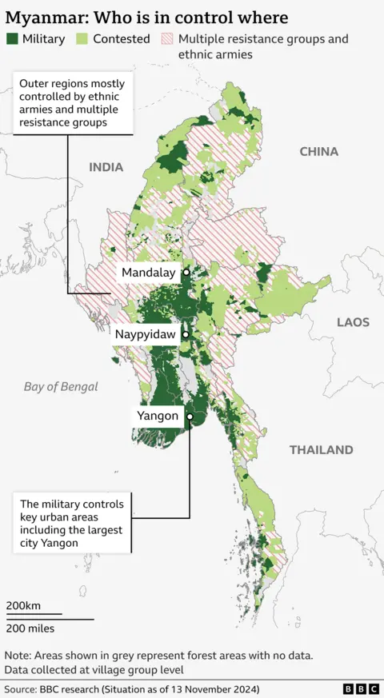
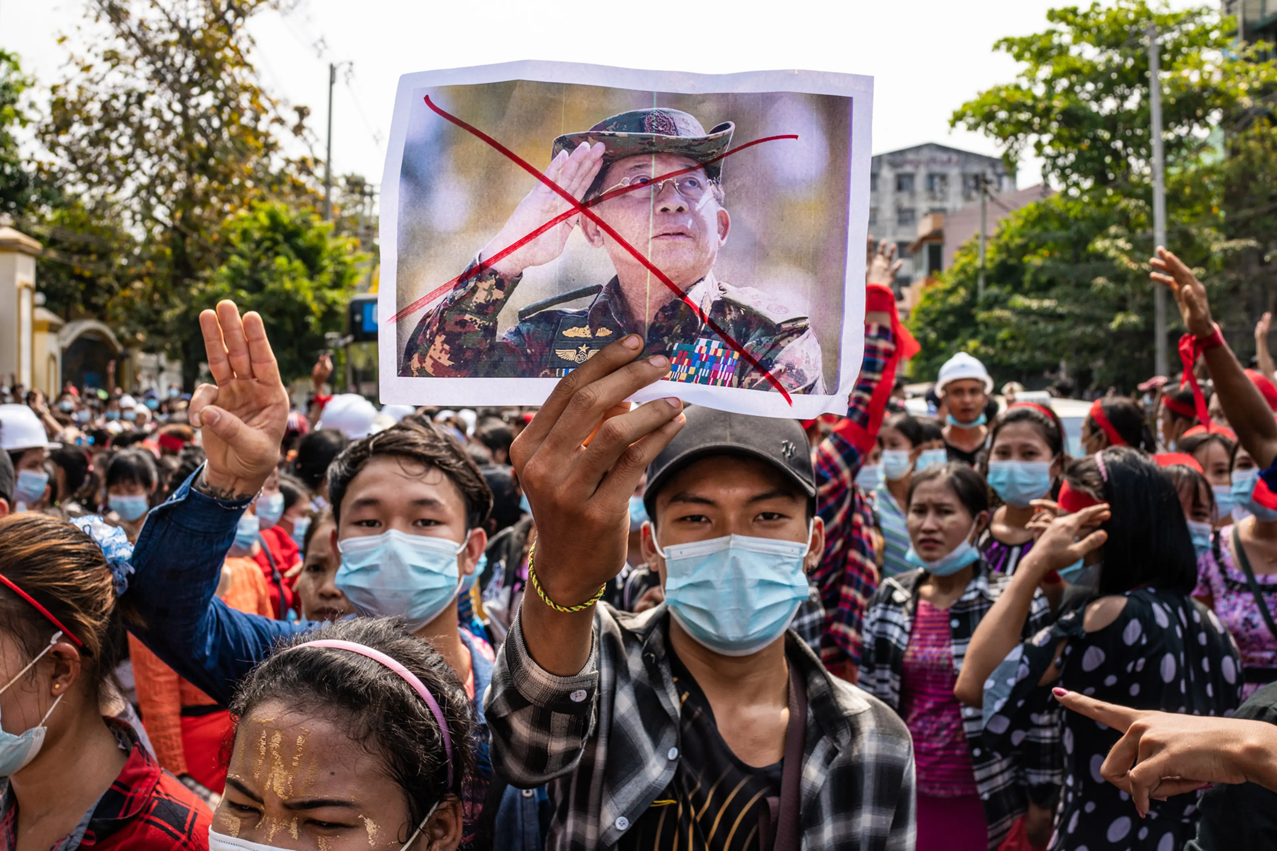
Primer on Myanmar and the Myanmar Civil War
February 1st, 2021
The Tatmadaw launched a coup d'état
Deposed and detained President Win Myint and State Counsellor Suu Kyi
Then to 2024
Nation-wide protests against the military junta
Thousands non-state resistance groups (e.g., military arm of the exiled government and ethnic minority armies) rose to combat the military junta
(Getty Image)
Notes:
In response, the military junta has resorted to indiscriminate attacks and restricted civilian access to essential resources. By late 2021, at least 1,500 people were killed by the military.

Slide 16
Primer on Myanmar and the Myanmar Civil War
2024 marked the most devastating year for civilians in Myanmar
>1,800 civilians killed and over 40% of which were women and children (United Nations High Commissioner for Refugees, 2025a)
>18 million people or 1/4 of the population relying on humanitarian assistance (United Nations Office for the Coordination of Humanitarian Affairs, 2024)
>3.5 million people displaced across the country (United Nations High Commissioner for Refugees, 2025b)
Ranked second to last in the Democracy Index (Economist Intelligence Unit, 2024)
Becoming “a forgotten crisis” (Htet et al., 2024; United Nations, 2024)
Likely underestimates of the suffering of the people in Myanmar
Economist Intelligence Unit. (2025). Democracy Index 2024. https://www.eiu.com/n/campaigns/democracy-index-2024/
United Nations. (2024, April 4). As Crisis in Myanmar Worsens, Security Council Must Take Resolute Action to End Violence by Country’s Military, Address Humanitarian Situation, Speakers Urge. https://press.un.org/en/2024/sc15652.doc.htm
United Nations High Commissioner for Refugees. (2025a). Update on the Human Rights Situation in Myanmar Overview of developments in 2024.
United Nations High Commissioner for Refugees. (2025b). Myanmar UNHCR displacement overview 30 Dec 2024. https://data.unhcr.org/en/documents/details/113509
United Nations Office for the Coordination of Humanitarian Affairs. (2024). Myanmar Humanitarian Update No. 41. United Nations. https://reliefweb.int/report/myanmar/myanmar-humanitarian-update-no-41-10-october-2024

Slide 17
Limited existing evidence on mental health and well-being consequences of the coup d'état
Nationwide population-based survey of Burmese adults (N=1,038) 5 months following the coup (Fan et al., 2024) 1/3 had post-traumatic stress disorder, anxiety, or depression.
Non-probability adult sample (N=7,720) in October 2021 (Saw et al., 2023)
60% of them had probable depression, anxiety, and both
Purposive sample of young girls and women (N=750) from disadvantaged communities 2.5-3 years since the coup (Pearson et al., 2025)
>80% of the respondents reported at least one conflict-related stressors
Such exposure put them 2.5 times more likely to develop any depression symptoms
Fan, X., Ning, K., Ma, T. S., Aung, Y., Tun, H. M., Zaw, P. P. T., Flores, F. P., Chow, M. S., Leung, C. M., Lun, P., Chang, W. C., Leung, G. M., & Ni, M. Y. (2024). Post-traumatic stress, depression, and anxiety during the 2021 Myanmar conflict: A nationwide population-based survey. The Lancet Regional Health - Southeast Asia, 26. https://doi.org/10.1016/j.lansea.2024.100396
Pearson, I., Chase, E., Van Kim, C., San, N. M., Ja, H., Hlaing, Z. M., Oo, N., Lae, K., Soe, E. E., Zobrist, B., Zimmerman, C., & Ranganathan, M. (2025). Conflict exposure and mental health: A survey of adolescent girls and young women in Myanmar post the 2021 coup d’état. Conflict and Health, 19(1), 29. https://doi.org/10.1186/s13031-025-00668-y
Saw, H.-W., Owens, V., Morales, S. A., Rodriguez, N., Kern, C., & Bach, R. L. (2023). Population mental health in Burma after 2021 military coup: Online non-probability survey. BJPsych Open, 9(5), e156. https://doi.org/10.1192/bjo.2023.550
Notes:
The lack of long-term studies once again illustrated how Myanmar has slowly faded in the international news and international research communities.
Furthermore, the psychological consequences of war and conflict extend beyond development of mental disorders.

Slide 18
Current Study
To investigate the short and long-term well-being trends in Myanmar
in the backdrop of political turmoil
Specifically, to
document the trends of subjective well-being (SWB) in Myanmar in the past decade (2014-2024), with the focus on coup d'état and subsequent war
identify segments of the Burmese population most impacted by the ongoing conflict
estimate the changes in SWB attributable to the conflicts using multi-level models
Notes:
The lack of long-term studies once again illustrated how Myanmar has slowly faded in the international news and international research communities.
Furthermore, the psychological consequences of war and conflict extend beyond development of mental disorders.

Slide 19
Current Study
Gallup World Poll
Individual-level data on SWB, sociodemographics (e.g., age, gender, religion), living necessities (e.g., food and shelter), political attitudes, geographical locations
Armed Conflict Location & Event Data
Sub-country geo-located conflict events
Other datasets in consideration
Global Peace Index: 23 indicators to assess ongoing domestic conflicts, societal safety and security, and militarization
Fragile State Index: over 100 indicators to assess a country’s vulnerability
Notes:
The lack of long-term studies once again illustrated how Myanmar has slowly faded in the international news and international research communities.
Furthermore, the psychological consequences of war and conflict extend beyond development of mental disorders.

Slide 20
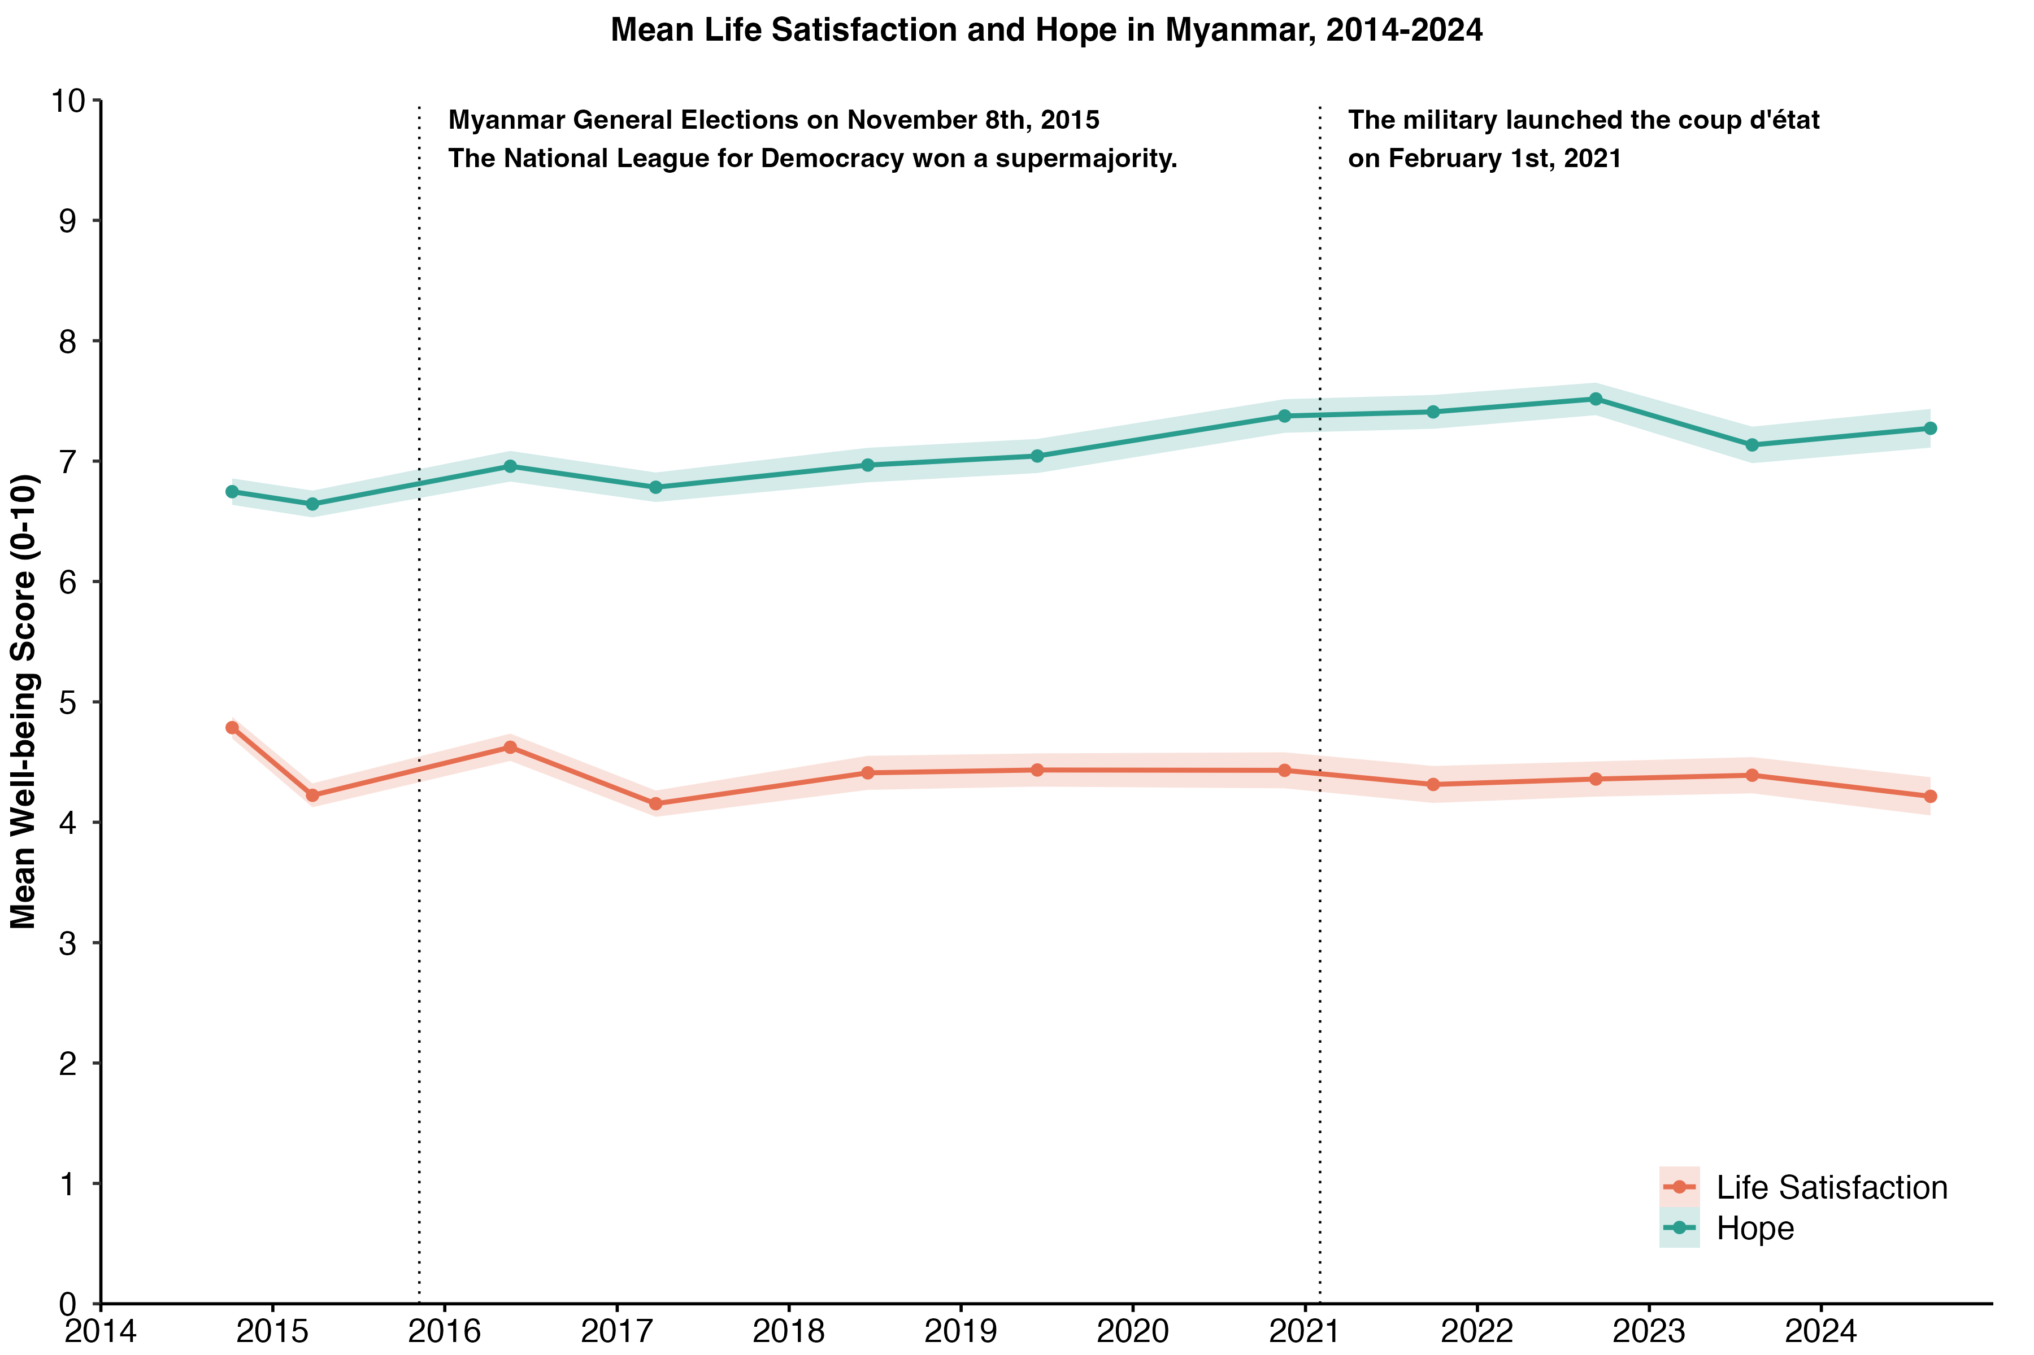
Trend of Life Satisfaction and Hope, 2014-2024
Notes:
Drastic changes in life circumstances (from starting of a war to conclusion of a war without prudent planning) could result in enduring changes in subjective well-being of the affected populations, even in the presence of the usual protective factors (e.g., better social support, being female, and high income and education levels).
Context matters a lot. The impetus of every war is different. Developing an understanding of the historical, cultural, and political context of the countries/ settings where the conflicts take place is essential for well-being researchers to conduct the study.Example: Geographical differences in subjective well-being due to e.g., exposure to conflict and allegiance to certain political groups
Studying individual conflicts offer us the opportunity to tease apart the common well-being impacts of conflicts, while highlighting the some of the forgotten conflicts happening in the world.

Slide 21
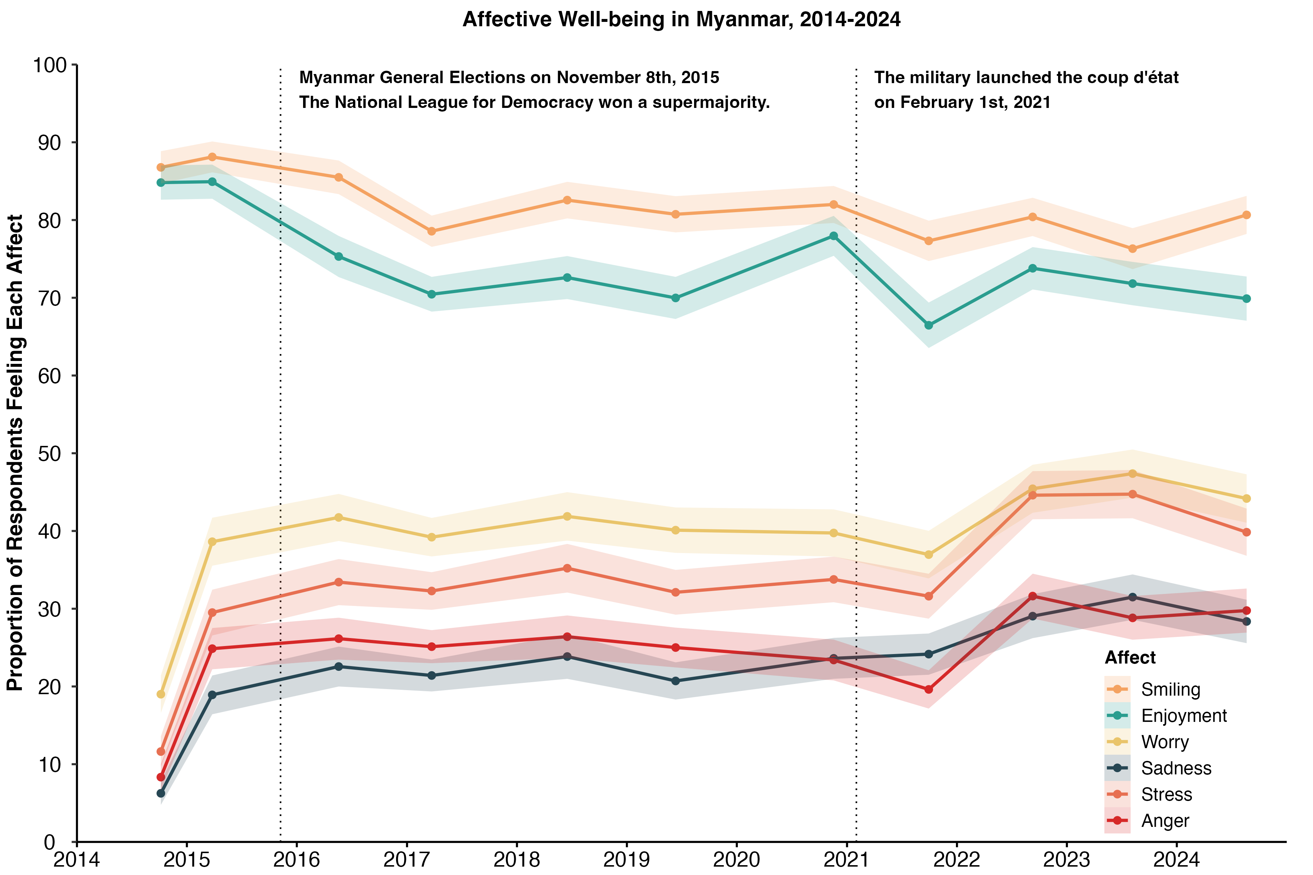
Trend of Affect, 2014-2024
Notes:
Drastic changes in life circumstances (from starting of a war to conclusion of a war without prudent planning) could result in enduring changes in subjective well-being of the affected populations, even in the presence of the usual protective factors (e.g., better social support, being female, and high income and education levels).
Context matters a lot. The impetus of every war is different. Developing an understanding of the historical, cultural, and political context of the countries/ settings where the conflicts take place is essential for well-being researchers to conduct the study.Example: Geographical differences in subjective well-being due to e.g., exposure to conflict and allegiance to certain political groups
Studying individual conflicts offer us the opportunity to tease apart the common well-being impacts of conflicts, while highlighting the some of the forgotten conflicts happening in the world.

